Slide 1
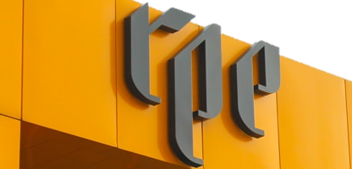
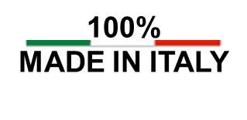
RPE Srl
Leader in Fluid Management Control
R Series
3 way exchange
www.rpesrl.it

Slide 2

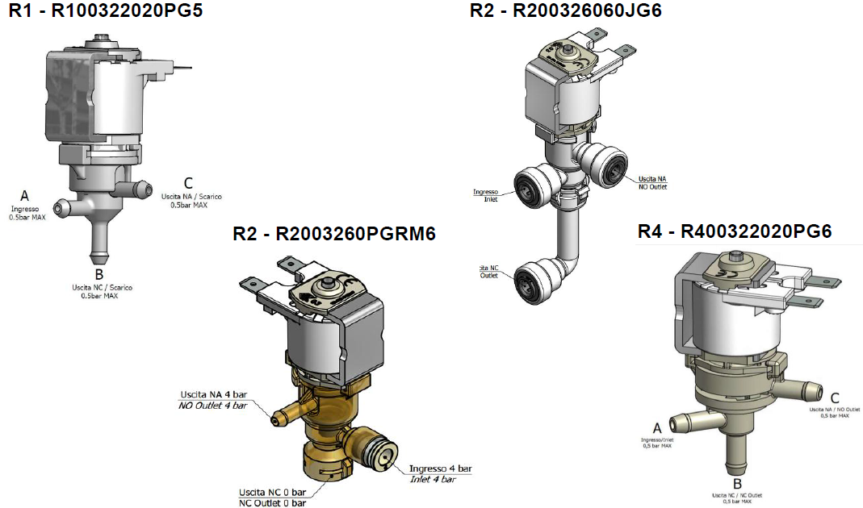
R Series 3 way exchange

Slide 3
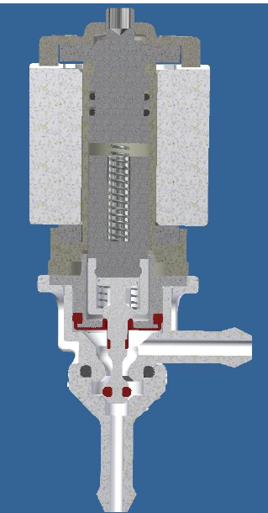
R Series 3 way exchange
Product characteristics
Medium separation
Thanks to the diaphragm that separates the armature tube from the body where the fluid works
4. Food approvals material
All the materials in contact with fluid are POM or LSR
2. Self cleaning
Each time the core is activated, it cleans the orifice by itself where fluid passes through
3. Easy maintenance
Thanks to the bayonet assembly it can be disassembled easily without any screwdriver

Slide 4
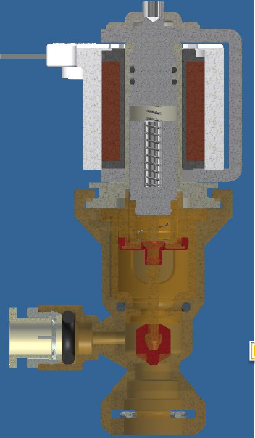
R Series 3 way exchange
Product characteristics
Medium separation
Thanks to the diaphragm that separates the armature tube from the body where the fluid works
4. Food approvals material
All the materials in contact with fluid are PPSU or LSR
2. Quick connections
We use a ROEMER cartridge directly fixed in the connection
3. Transparent
Thanks to the PPSU material it is easy to understand if there is any residue of fluid inside the valve (e.g. milk)

Slide 5
R Series 3 way exchange
Product characteristics
Medium separation
Thanks to the diaphragm that separates the armature tube from the body where the fluid works
4. Food approvals material
All the materials in contact with fluid are POM or LSR
2. Self cleaning
Each time the core is activated, it cleans the orifice by itself where fluid passes through
3. Double O-Ring
The functioning pin works on a double O-ring and guaranties the perfect cleaning of the orifice

Slide 6
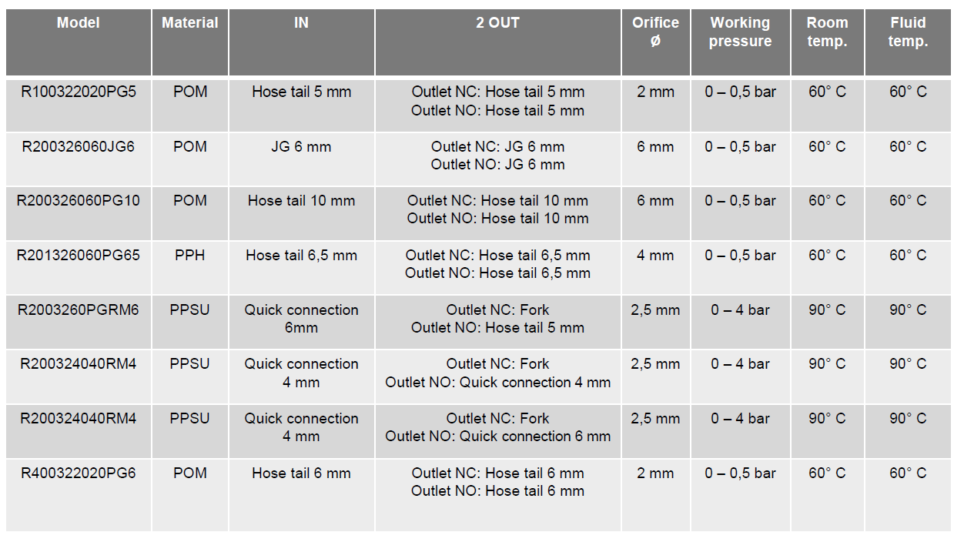
R Series 3 way exchange
models

Slide 7
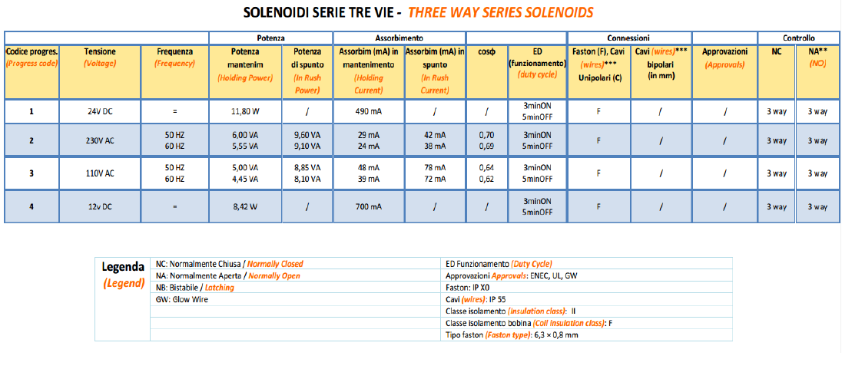
R Series 3 way exchange
solenoids

Slide 8
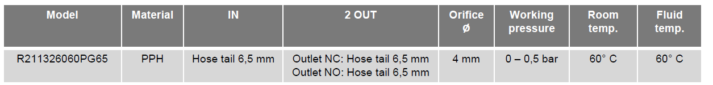
R Series 3 way exchange
solenoids

Slide 9

NOTHING GREAT HAS EVER BEEN DONE WITHOUT PASSION
Thanks for your attention
www.rpesrl.it

